Slide 1
Disruptions of the 4th Industrial Revolution
The Internet of Things & 3D Printing
Randy Rausch
randy@socialtorch.org

Slide 2




Industrial Revolutions
1st 1760-1840
2nd 1870-1914
3rd 1950-2000
4th Now
STEAM
ELECTRICITY
COMPUTERS
CYBER-PHYSICAL SYSTEMS
Steam and water power replace humans power with machines
Assembly lines produce
internal combustion engines, airplanes, cars, and radios.
Electronics, the Internet and computers further automate production and enable globalization
Big data, connectivity, and AI optimize the Internet of Things.
3D Printing uses Digital to create the Physical and revolutionize manufacturing

Slide 3
The Internet of Things (IoT)
Connected Home
Safety and Security
Energy Efficiency
Entertainment
Routine automation and alerts
Smart City
Smart Parking Meters
Smart Traffic Lights
Electric Vehicle Charging
Real-Time Analysis
Wearables
Fitness Bands
Smart Watches
Smart Glasses
Health Monitoring
Internet of Things
Connected Car
Safety and Security
Diagnostics
Infotainment and Nav
Fleet Management
Connected Government
Connected Public Admin
e-Government
Connected Civil Protection
Open311
Industrial Internet
Real-Time Analytics
Factory Automation
Robotics
Supply Chain Efficiency
The Internet of Things connects devices such as everyday consumer objects, industrial equipment, city infrastructure, and other assets, enabling information gathering and management of these devices to increase efficiency, enable new services, or achieve other health, safety, or environmental benefits
Notes:
The Internet of Things connects devices such as everyday consumer objects, industrial equipment, city infrastructure, and other assets, enabling information gathering and management of these devices via software to increase efficiency, enable new services, or achieve other health, safety, or environmental benefits

Slide 4
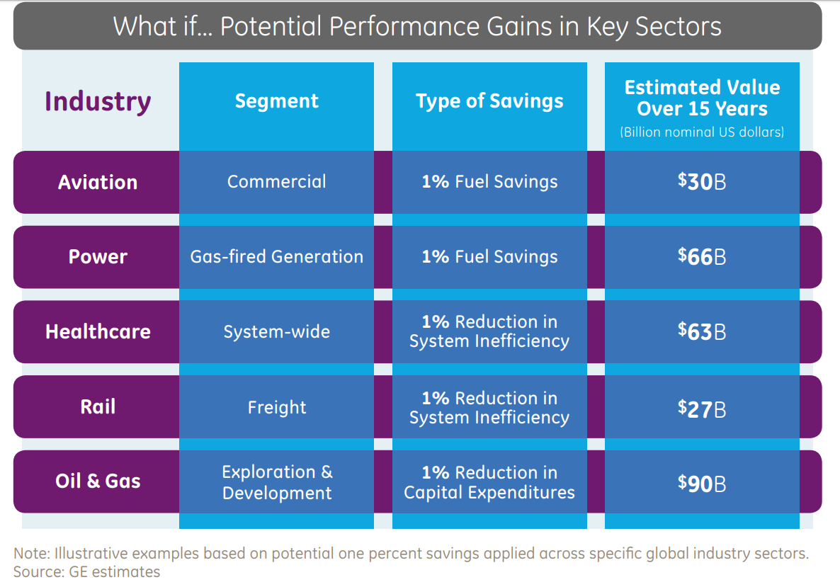
The Industrial Internet of Things (IIoT)

Slide 5

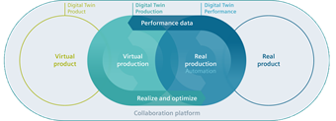
Key Enablers
60x
40x
Cost of Sensors
Cost of Processing
Cost of Bandwidth
Scalability of IPv6
$1.30
.60
IPv6
= 3.4 x 10³⁸
Avg. Cost
Over the past 10 years
Over the past 10 years
Over the past 10 years
IP Addresses
Ubiquitous Connectivity
Smartphones
Digital Twins
3rd Wave
Artificial Intelligence
WIFI
5G
Personal IoT Gateway
Better Models & Predictions
Contextual Adaptation

Slide 6
What if you had information on…
the state of all things around you
&
the capability to reason on that data?
Notes:
Give IoT Productivity Examples
Commuting
Manufacturing
Wind turbines
Power grid
Connected government
Etc.

Slide 7




Connected Government

Slide 8
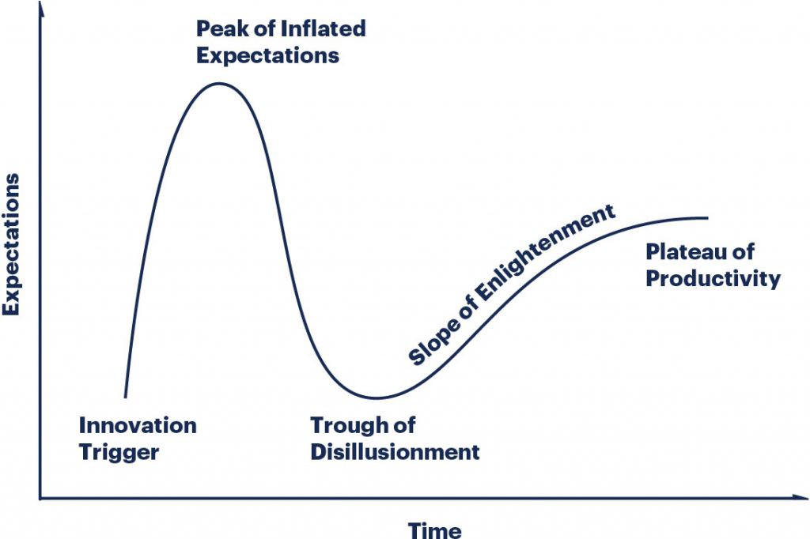
The Gartner Hype Cycle
IoT

Slide 9
IoT Disruptions
3 Groups will Emerge
Unawares
Nice Try's
Long-Term Winners
The real disruption of the Internet of Things
is Business Agility

Slide 10
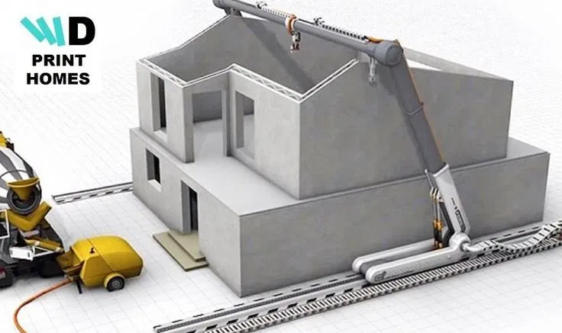

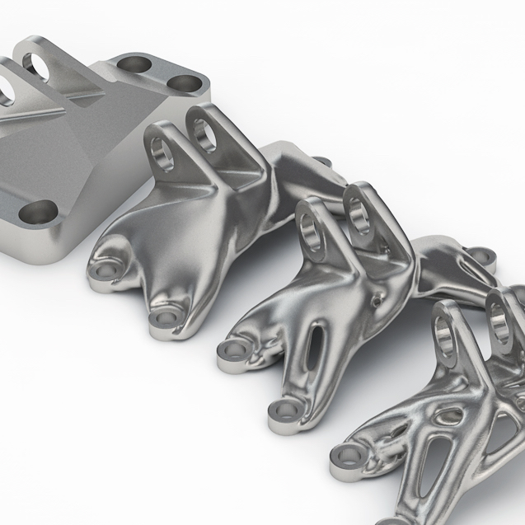
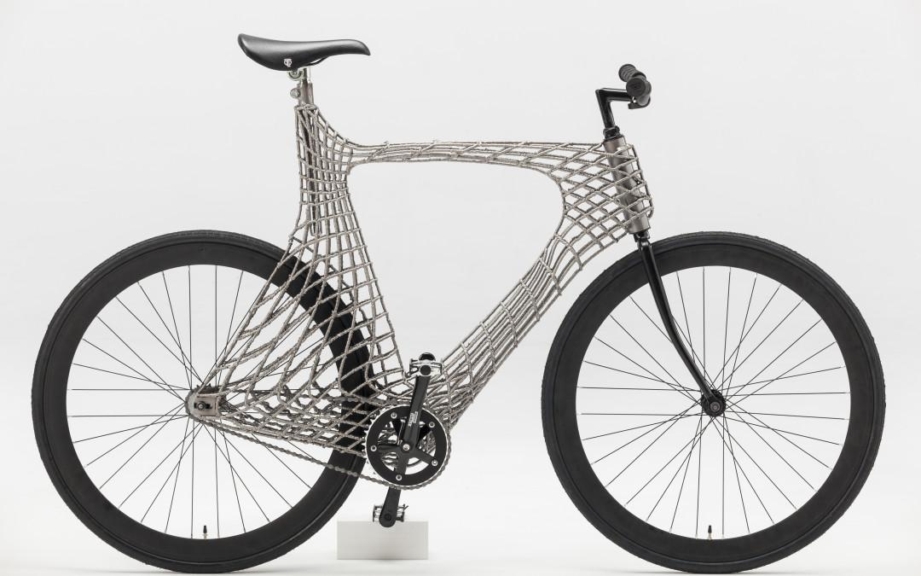
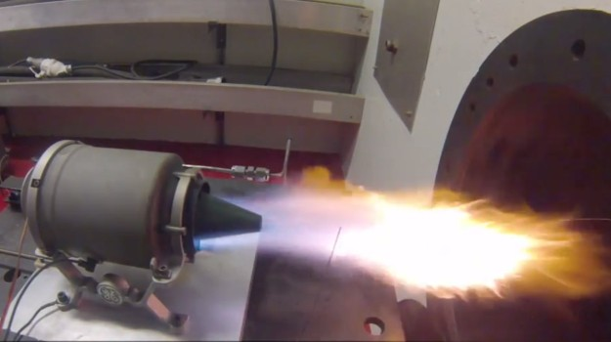
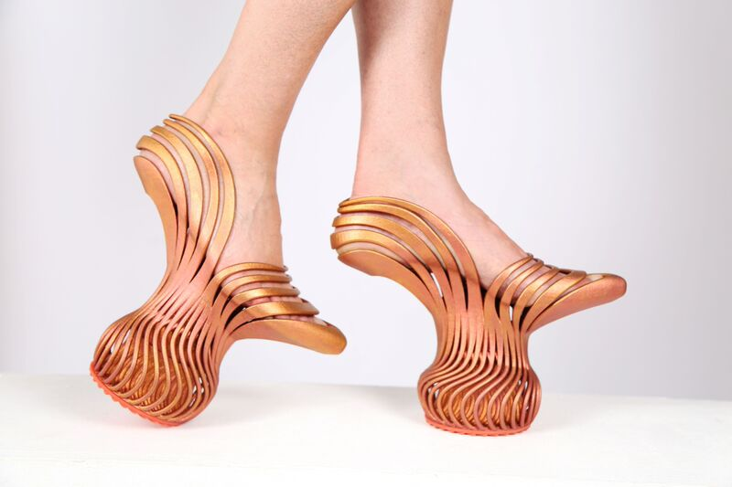
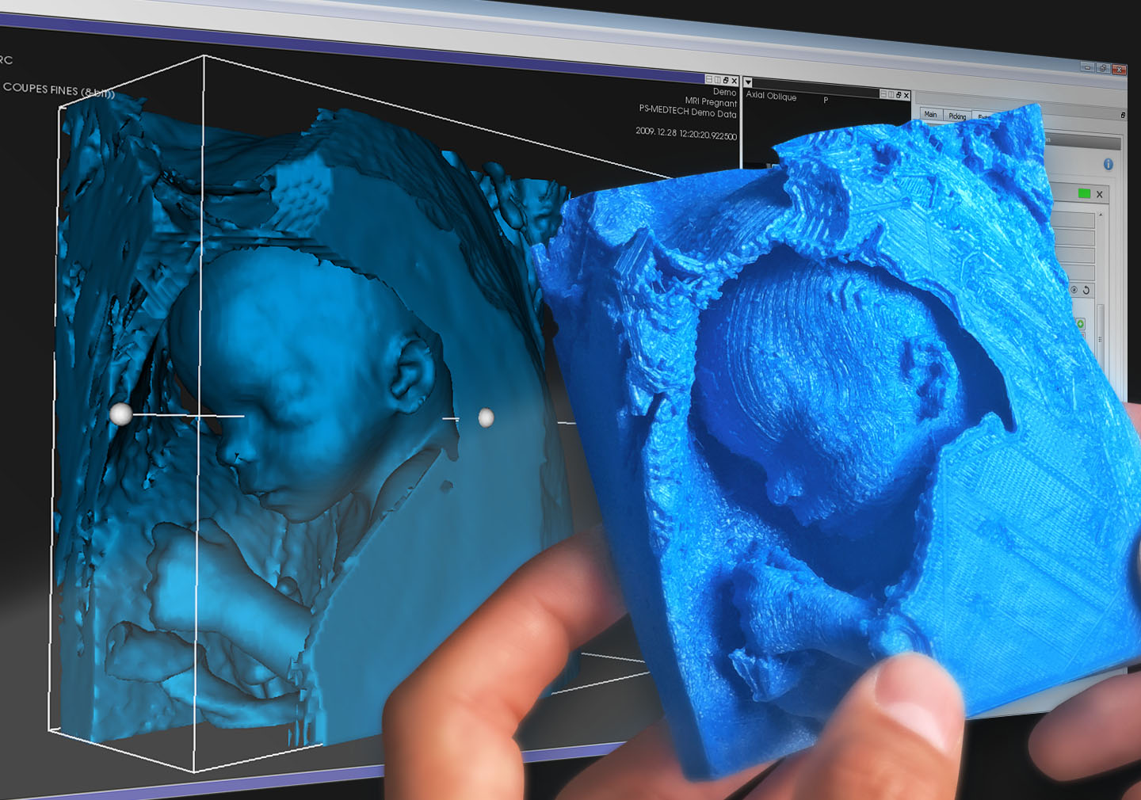
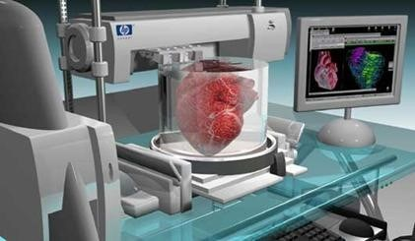
3D Printing (Additive Manufacturing)
Benefits:
Enables complex geometries
Consumes fewer raw-materials
Produces less waste
Consumes less energy
Decreased time-to-market
Printable Materials:
Thermoplastics
Metals
Ceramics
Biochemicals
Notes:
Additive manufacturing holds a potential that researchers, designers, and engineers could previously only dream of. There is much more freedom for design as parts are produced in one piece. This opens up countless opportunities, such as producing molds that until now were too complex and time-consuming to manufacture.
These could include designs such as three-dimensional and bionic structures modeled on forms found in nature.
Printable Materials:
Thermoplastics
Thermoplastic polymers remain the most popular class of additive manufacturing materials. Acrylonitrile butadiene styrene (ABS), polylactic acid (PLA) and polycarbonate (PC) each offer distinct advantages in different applications. Water-soluble polyvinyl alcohol (PVA) is typically used to create temporary support structures, which are later dissolved away.
Metals
Many different metals and metal alloys are used in additive manufacturing, from precious metals like gold and silver to strategic metals like stainless steel and titanium.
Ceramics
A variety of ceramics have also been used in additive manufacturing, including zirconia, alumina and tricalcium phosphate. Also, alternate layers of powdered glass and adhesive are baked together to create entirely new classes of glass products.
Biochemicals
Biochemical healthcare applications include the use of hardened material from silicon, calcium phosphate and zinc to support bone structures as new bone growth occurs. Researchers are also exploring the use of bio-inks fabricated from stem cells to form everything from blood vessels to bladders and beyond.

Slide 11
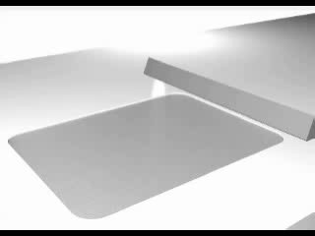
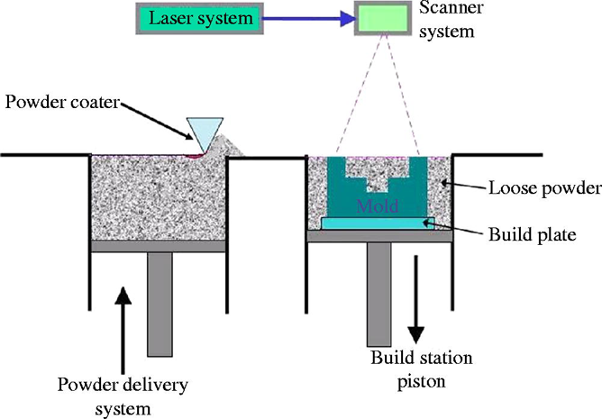

Direct Metal Laser Melting (DMLM)
1 in³ = 62 miles of micro-welds

Slide 12
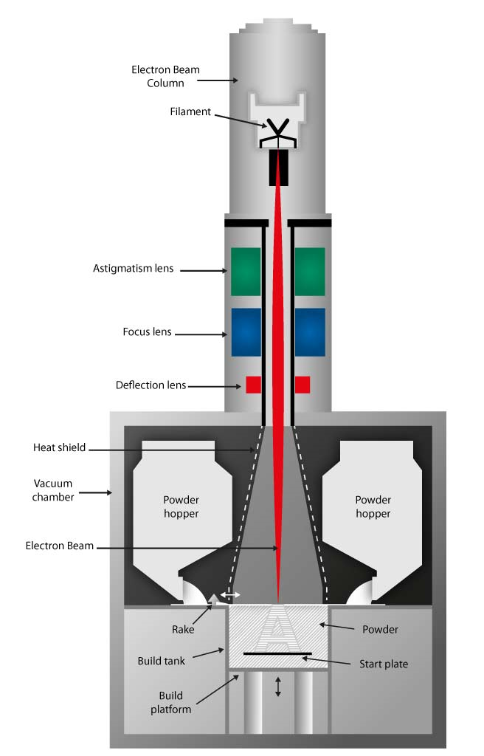
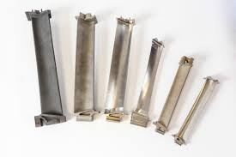
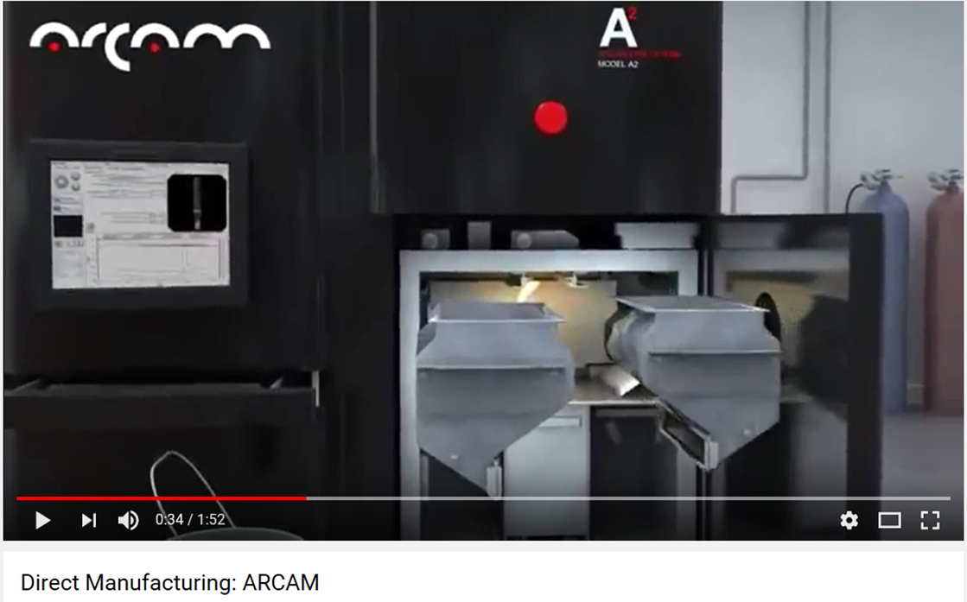
Electron Beam Technology
Current Applications
Aerospace
Medical implants
Material systems
Titanium alloys
Aluminum alloys
Copper & its alloys
Knee/Hip
Turbine blade

Slide 13
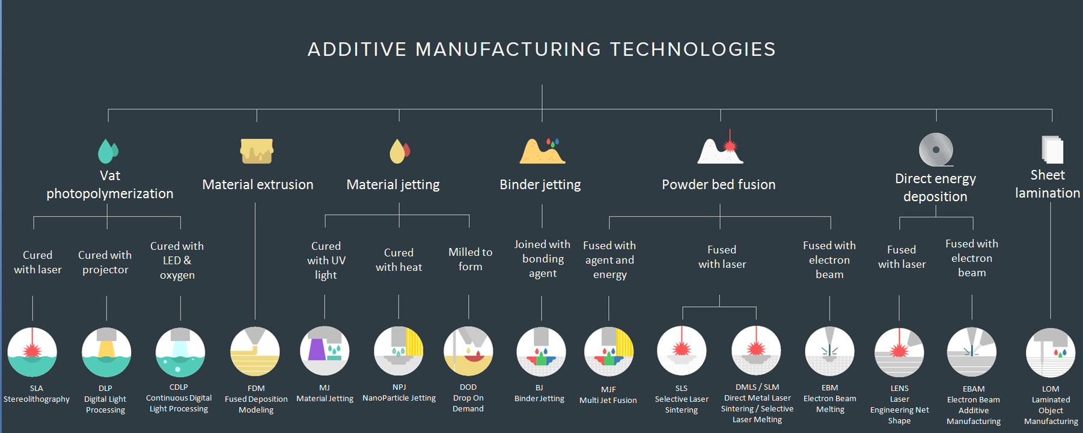
Additive Manufacturing Technologies
Notes:
Image credit: https://www.dsiac.org/sites/default/files/figure_1.png
Material Extrusion
Material extrusion is one of the most well-known additive manufacturing processes. Spooled polymers are extruded, or drawn through a heated nozzle mounted on a movable arm. The nozzle moves horizontally while the bed moves vertically, allowing the melted material to be built layer after layer. Proper adhesion between layers occurs through precise temperature control or the use of chemical bonding agents.
Directed Energy Deposition
The process of directed energy deposition (DED) is similar to material extrusion, although it can be used with a wider variety of materials, including polymers, ceramics and metals. An electron beam gun or laser mounted on a four- or five-axis arm melts either wire or filament feedstock or powder.
Material Jetting
With material jetting, a print head moves back and forth, much like the head on a 2D inkjet printer. However, it typically moves on x-, y- and z-axes to create 3D objects. Layers harden as they cool or are cured by ultraviolet light.
Binder Jetting
The binder jetting process is similar to material jetting, except that the print head lays down alternate layers of powdered material and a liquid binder.
Sheet Lamination
Laminated object manufacturing (LOM) and ultrasonic additive manufacturing (UAM) are two sheet lamination methods. LOM uses alternate layers of paper and adhesive, while UAM employs thin metal sheets conjoined through ultrasonic welding. LOM excels at creating objects ideal for visual or aesthetic modeling. UAM is a relatively low-temperature, low-energy process used with various metals, including titanium, stainless steel and aluminum.
Vat Polymerization
With vat photopolymerization, an object is created in a vat of a liquid resin photopolymer. A process called photopolymerization cures each microfine resin layer using ultraviolet (UV) light precisely directed by mirrors.
Powder Bed Fusion
Powder Bed Fusion (PBF) technology is used in a variety of AM processes, including direct metal laser sintering (DMLS), selective laser sintering (SLS), selective heat sintering (SHS), electron beam melting (EBM) and direct metal laser melting (DMLM). These systems use lasers, electron beams or thermal print heads to melt or partially melt ultra-fine layers of material in a three-dimensional space. As the process concludes, excess powder is blasted away from the object.

Slide 14
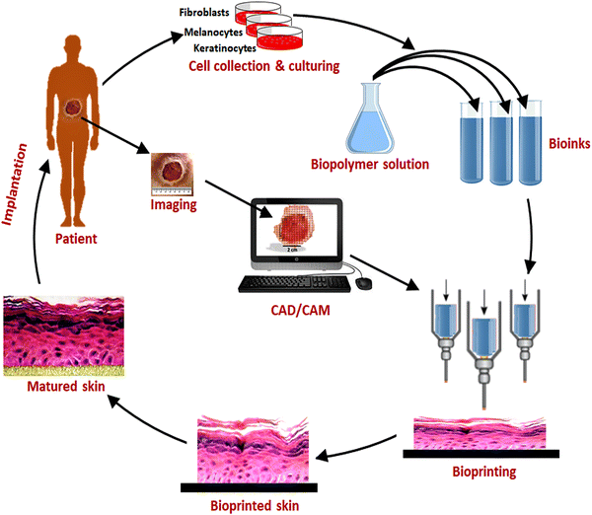
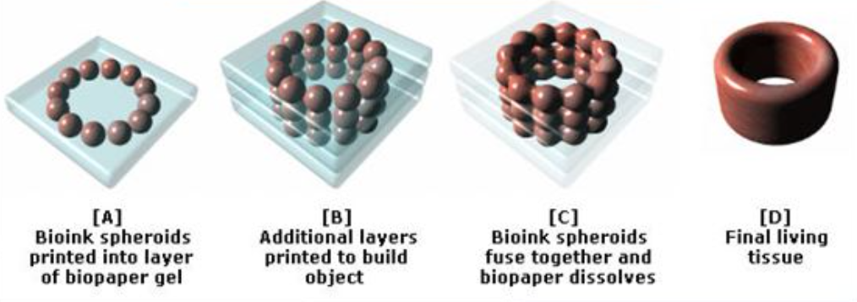
Bioprinting
Notes:
Image credit: https://link.springer.com/article/10.1007/s40204-018-0087-0
The process principally involves preparation, printing, maturation, and application. This can be summarized in the three key steps:
Pre-bioprinting involves creating the digital model that the printer will produce. The technologies used are computed tomography (CT) and magnetic resonance imaging (MRI) scans.
Bioprinting is the actual printing process, where bioink is placed in a printer cartridge and deposition takes place based on the digital model.
Post-bioprinting is the mechanical and chemical stimulation of printed parts so as to create stable structures for the biological material.

Slide 15
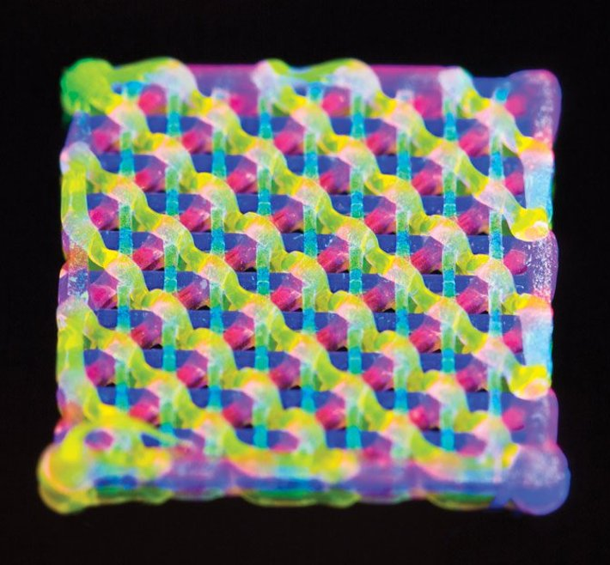
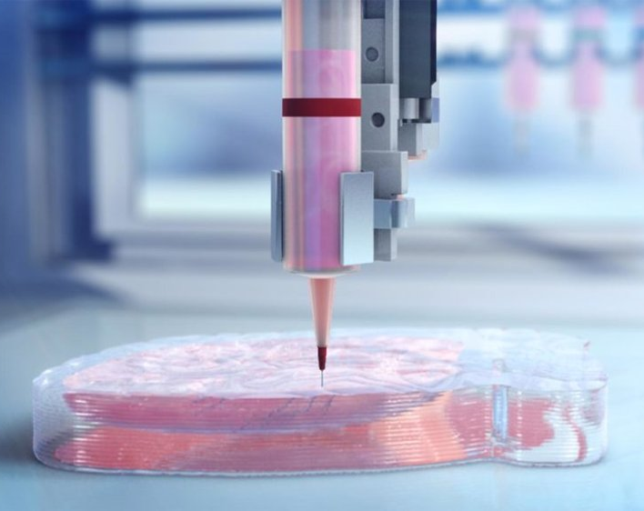
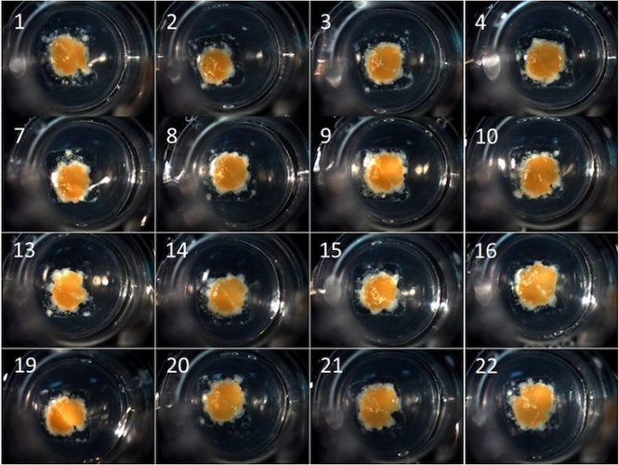
3D Printed Organs
Kidney
Heart
Liver
Lattice structure created with the Lewis Labs bioink
Source: MIT Technology Review
Scaffold based bioprinting of the heart
Source: Biolife4D
Bioprinted liver tissue in cell dishes
Source: Xconomy
Notes:
https://all3dp.com/2/5-most-promising-3d-printed-organs-for-transplant/

Slide 16

Manufacturing Economics Refresher
$
$$$

Slide 17

Manufacturing Economics Refresher Cont.

Slide 18
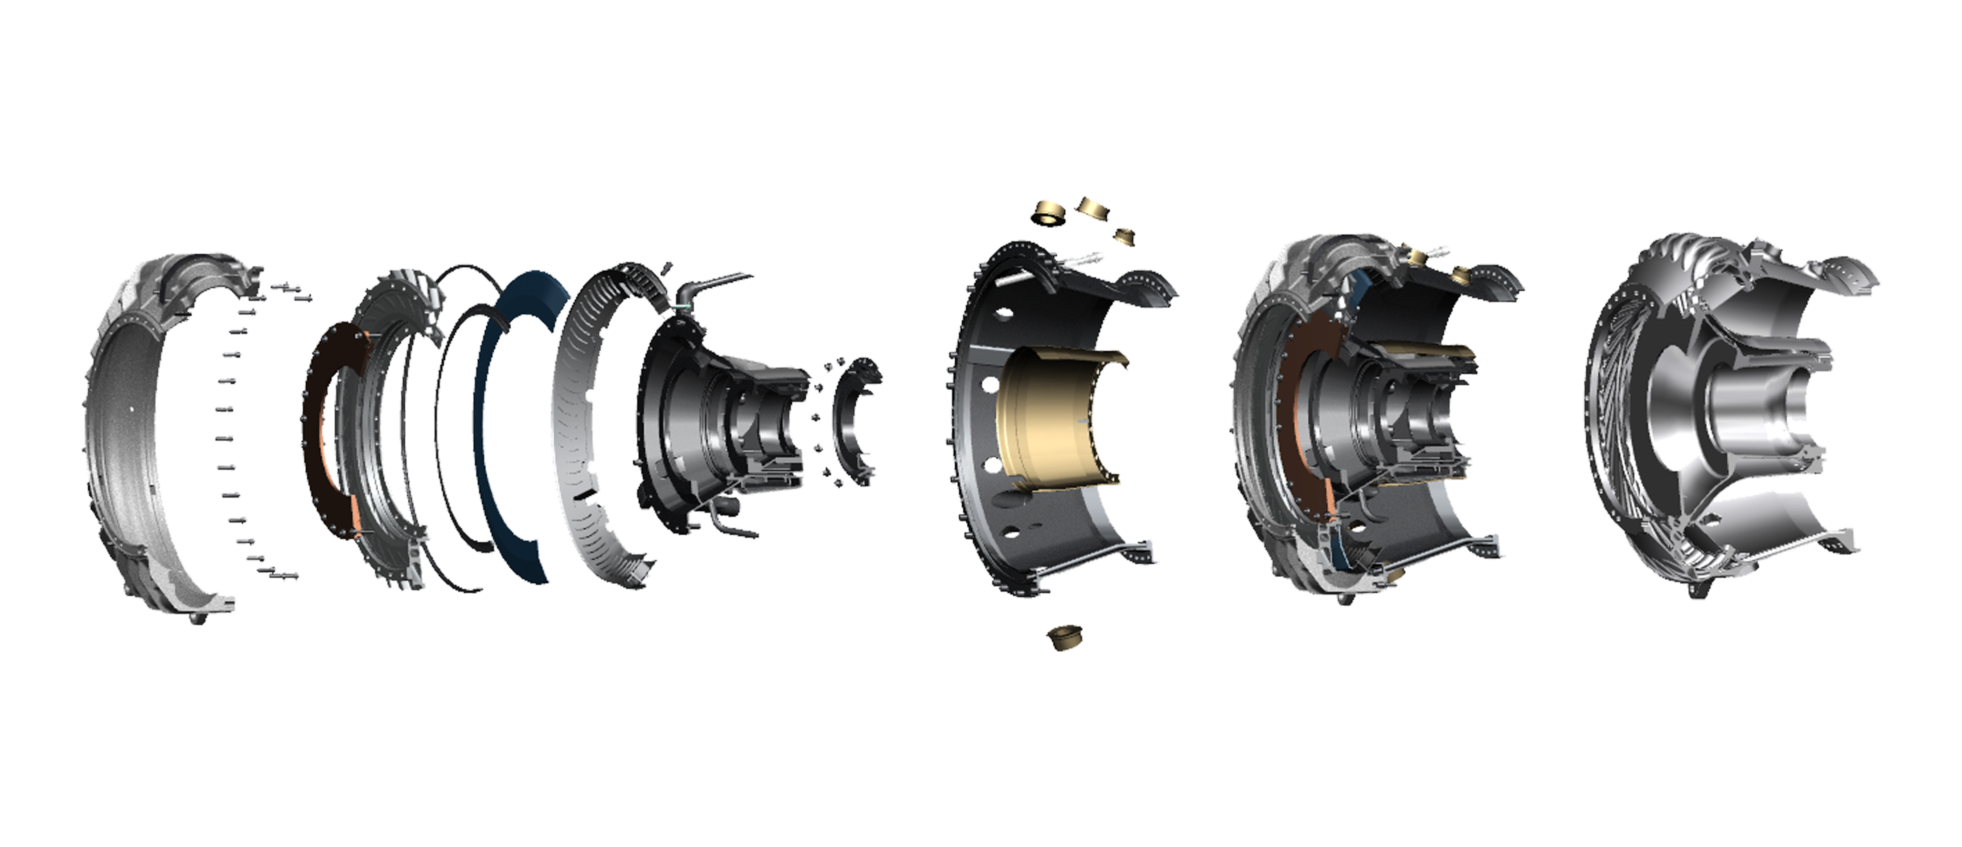
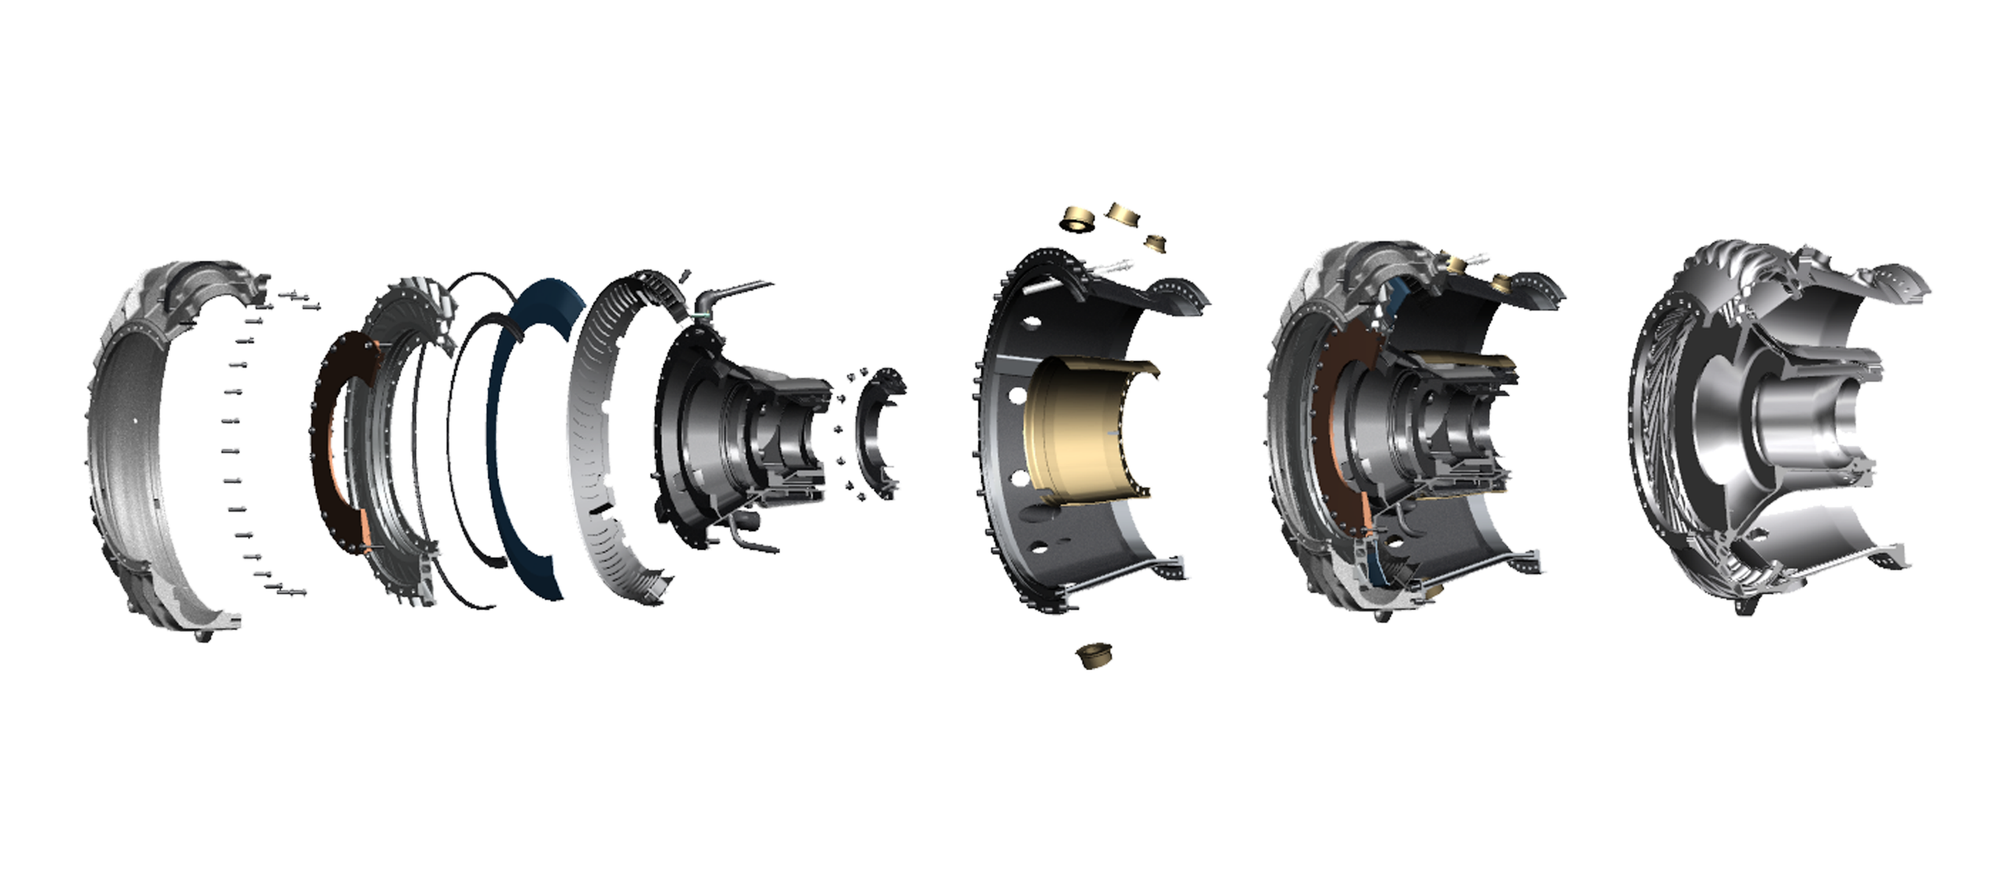
3D printing is disrupting Engineering, Manufacturing, and Supply Chains
}
Engineers
Manufacturing Systems
Parts
Traditional
60
50
~300
weight reduction
10+
3D Printed
~6
1
1
lbs.
Notes:
Here on this image we see center midframe superstructure of T901 engine which is conventionally assembled from 300 parts to 7 assemblies. These are the kind of engines power helicopters and fixed wing aircraft such as Bell 525 and Sikorsky S-70 and S-92

Slide 19
3D Printing Disruptions
Distributed Manufacturing will democratize technology
Manufacturing uber model
Demands a reinvention of education system
3D Printing will affect ~50% of global GDP
And disrupt engineering, manufacturing, and supply chains

Slide 20

Backup
Thank you
randy@socialtorch.org

Slide 21
Backup
Backup

Slide 22



Notes:
Image credit: https://storage.googleapis.com/titlemax-media/56c8474c-how-to-earn-money-without-traditional-job-3_compressed.png
https://www.visualcapitalist.com/150-apps-power-gig-economy/
It’s estimated that 57 million people in the U.S. now participate in the gig economy each year in some shape or form.

Slide 23
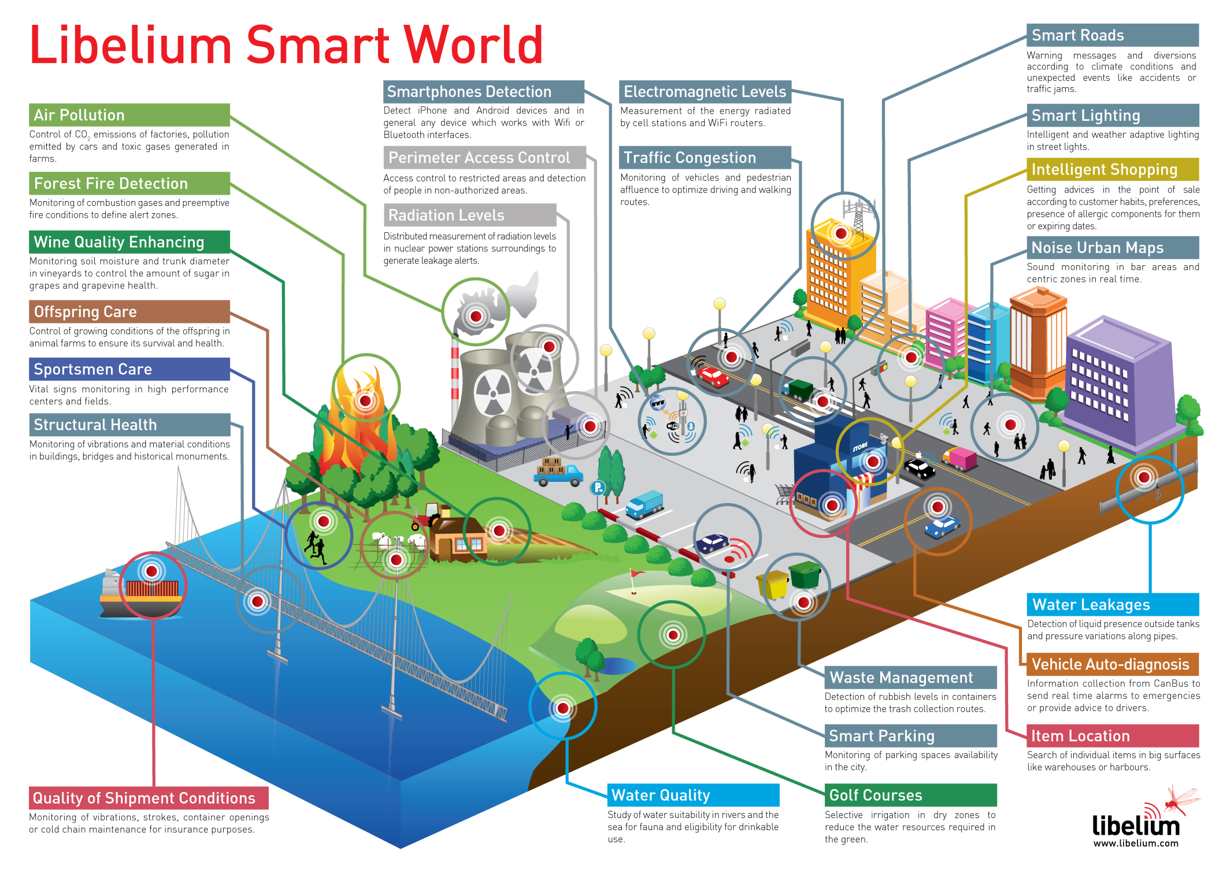
Internet of Things

Slide 24
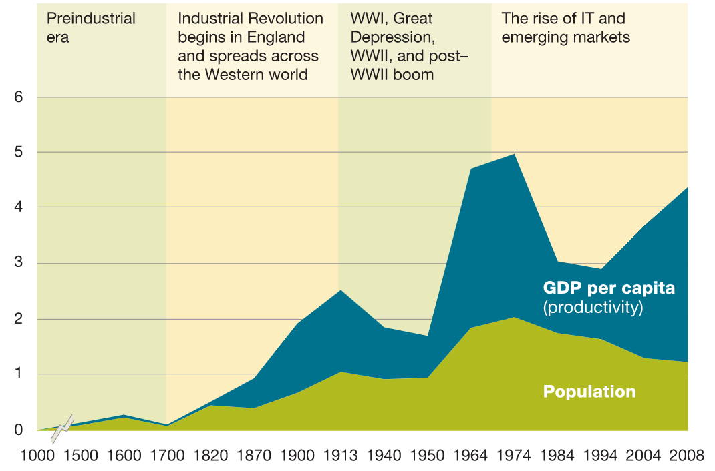
World GDP Growth Rates
CAGR %
Compound annual growth rate
Source: McKinsey Global Institute analysis based on data from economist Angus Maddison
Notes:
Gross domestic products (GDP) is a monetary measure of the market value of all the final goods and services produced in a specific time period, often annually.

Slide 25
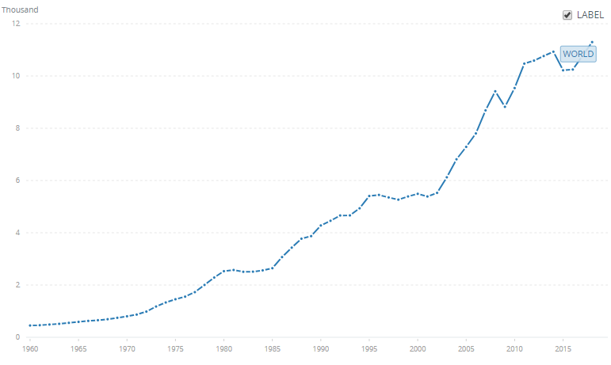
Global GDP per capita
Source: World Bank national accounts data and OECD National Accounts data files
Notes:
https://www.mckinsey.com/featured-insights/employment-and-growth/a-productivity-perspective-on-the-future-of-growth
The story behind global GDP growth over the decades can be broken down into two pieces: growth from an increase in the number of employed persons and growth from labor productivity
Throughout history, economic growth has been fueled by two factors: the expanding pool of workers and their rising productivity. From the perspective of rising prosperity, however, it is productivity that makes all the difference. Disparities in GDP per capita among countries—or between the past and the present in the same country—primarily reflect differences in labor productivity. That in turn is the result of production and operational factors, technological advances, and managerial skills. As managers improve efficiency, invest, and innovate to be competitive, their collective actions expand the global economy.
A productivity-based perspective on the future of growth suggests that a demographic slowdown today need not lead to economic stagnation tomorrow.
recognize productivity improvements as the primary source of sustained and long-term economic growth. To raise economic performance, we must focus on the causes of productivity differences among companies, industries, sectors, and countries.

Slide 26
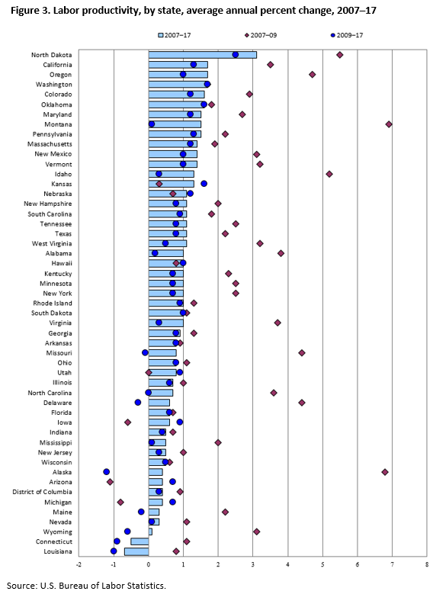
Labor productivity Average annual percent change, by state, 2007-2017

